Slide 1
How does music affect the brain and influence our mood
Notes:
Click to add Notes

Slide 2
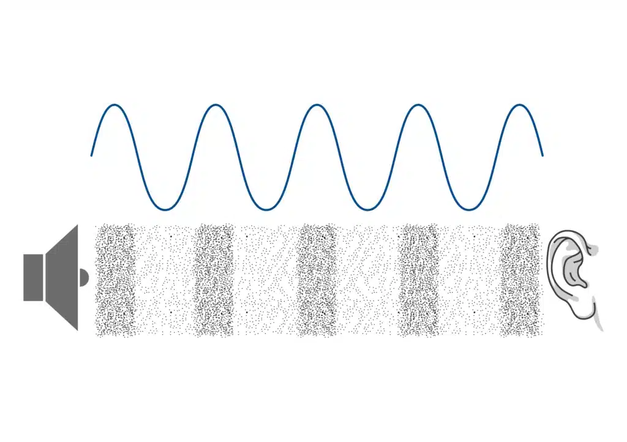

Music
Music is the arrangement of sound to create a combination of form, harmony, melody, rhythm, or other expressive content.
Notes:
Click to add Notes

Slide 3
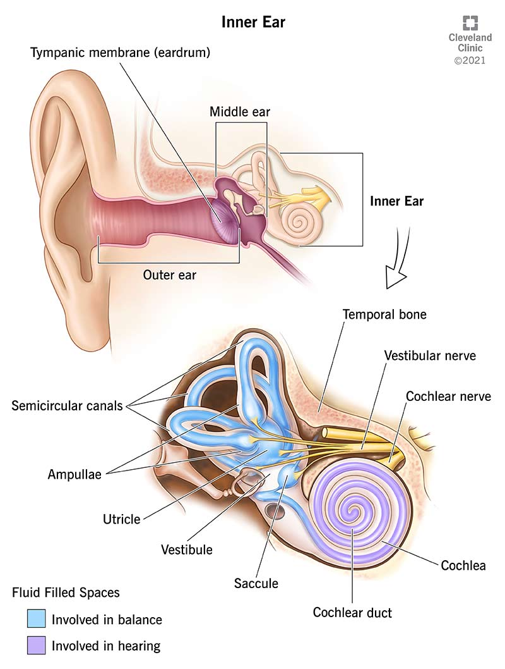
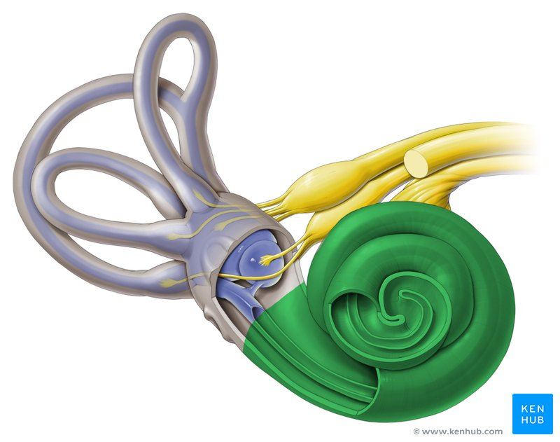
How do sound waves reach the brain
Notes:
Click to add Notes

Slide 4
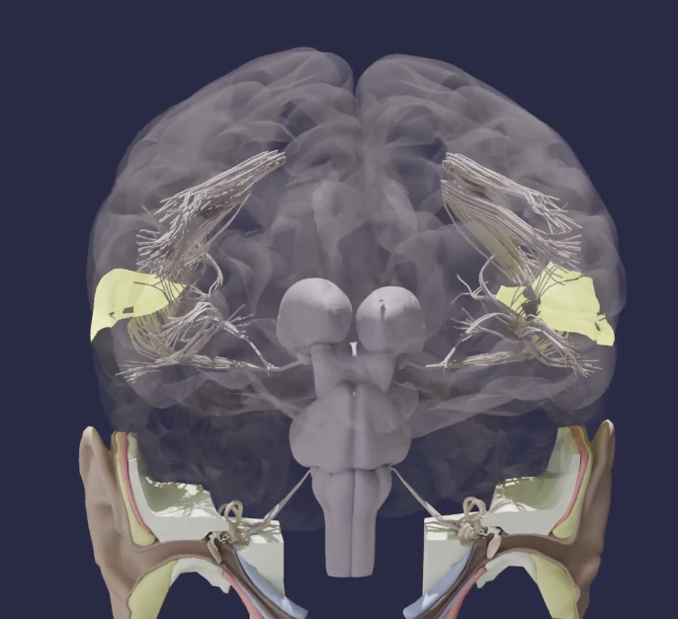
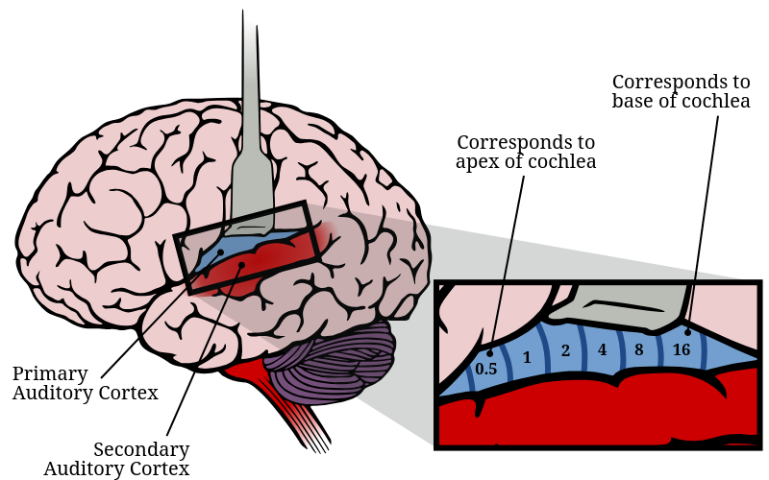
Auditory cortex
Notes:
Click to add Notes

Slide 5
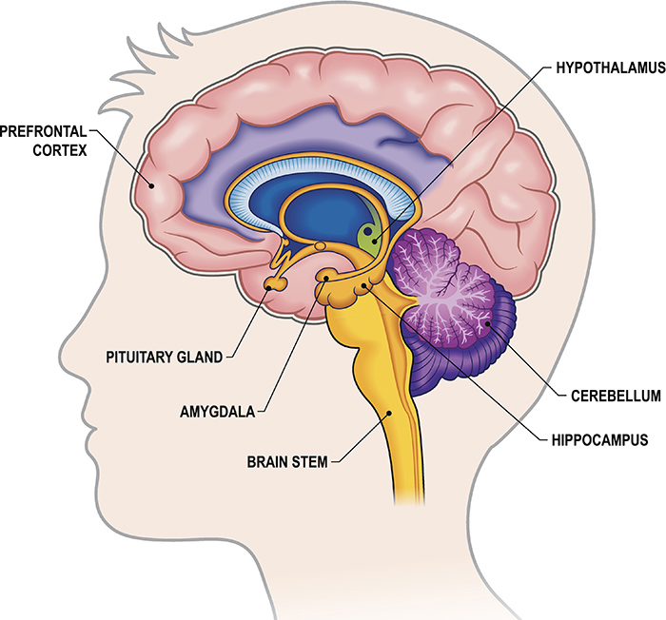
Limbic system
Regulating emotions, memories, motivation, reward and certain behavior.
Notes:
Click to add Notes

Slide 6
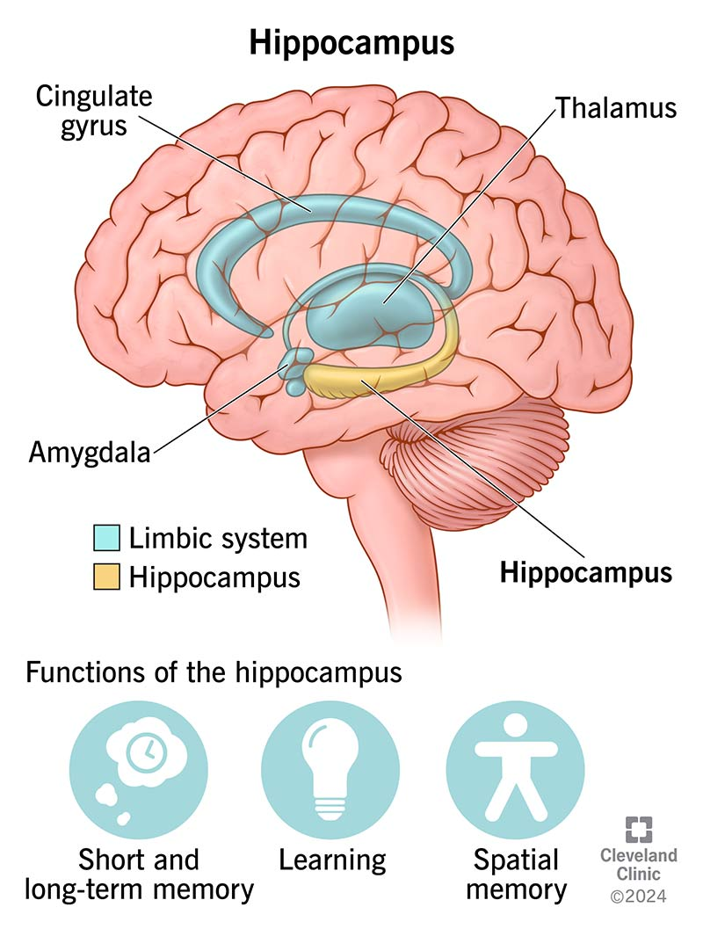
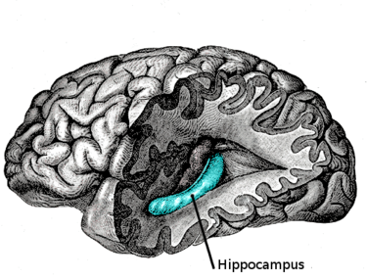
Hippocampus
This part of the limbic system links certain songs and music to memories.
Notes:
Click to add Notes

Slide 7
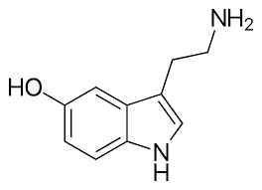
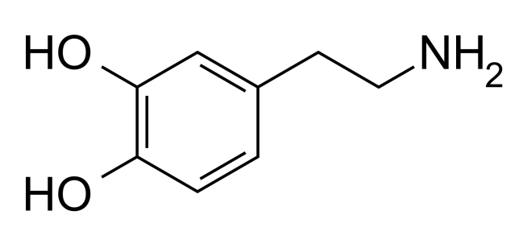
Brain chemistry
Dopamine
Serotonin
Notes:
Click to add Notes

Slide 8



Effect on the mood
Upbeat music – pop, edm, hip-hop, disco can boost your mood by increasing dopamine.
Sad music – (some classical), alternative helps process emotions, feel understood.
Metal, techno, rock, trap music boosts adrenaline and makes us feel more energized (workouts).
Slow, calming, ambient music helps lower stress.
Not listening to music
Listening to music
Notes:
Click to add Notes

Slide 9
Productivity
Classical or instrumental music can help you focus.
Lo-fi (low-fidelity), ambient music or noise music creates a relaxed work environment.
Fast-paced music can boost energy and motivation.
Notes:
Click to add Notes

Slide 10
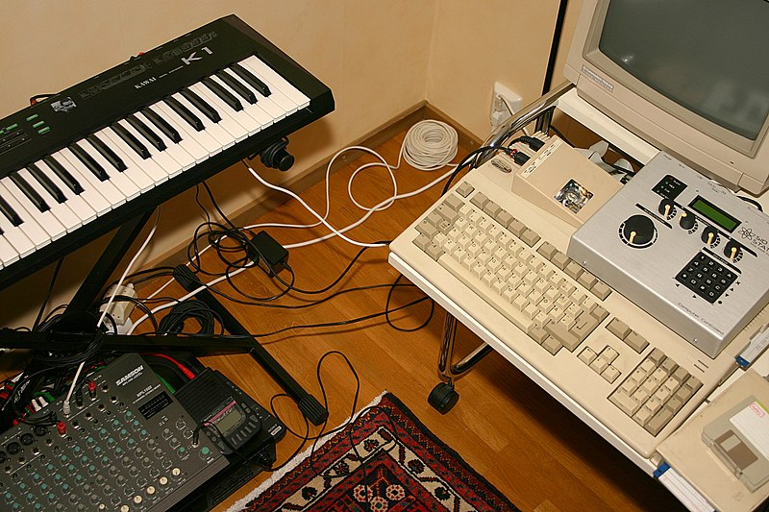

Low-fidelity
Style of music that uses background noise, static or distortion. Features beats, rhythms and melodies to create calm atmosphere.
Notes:
Click to add Notes

Slide 11

Ambient music
Style that focuses on creating a feeling. It’s usually slow and gentle. Features atmospheric textures, natural noises (wind, rivers, rain, birdsong), blending these elements to create a calming experience.
Notes:
Click to add Notes

Slide 12

Noise music
About exploring the different sounds our ears can hear.
White noise - sounds like a static sound on a TV or a radio, or like a strong wind.
Brown noise – deeper and rumbling sound.
Notes:
Click to add Notes

Slide 13
Quiz
1. Which part of the brain links music to memories?
Notes:
Click to add Notes

Slide 14
2. What chemical is released when we feel good?
Notes:
Click to add Notes

Slide 15
3. Which part of the ear converts vibrations into electrical signals?
Notes:
Click to add Notes

Slide 16
4. What color noise sounds like static?
Notes:
Click to add Notes

Slide 17
5. What type of music can boost energy and motivation?
Notes:
Click to add Notes

Slide 18
Thanks for watching!

